Slide 1

Balanced scorecard slide 1
Twitter Hurricane Analysis – Topic Modeling using LDA
Mouna Kalidindi
Supervised by : Dr. Somya Mohanty

Slide 2
INTRODUCTION
Social media platforms such as Twitter is being used as a basis for detecting, monitoring and analyzing the characteristics of both natural and man-made disasters.
Tweets volume over time, given a dataset over a small time window, we can filter the tweets to focus on disaster events based on the keywords.
The Goal of the project is to classify tweets as hurricane-related and non hurricane-related

Slide 3
Balanced scorecard slide 4
PROJECT FLOW
Understanding Data
Cleaning Data
Analyzing data
Supervised Learning
TF-IDF
Machine learning
1
2
Clustering
Topic Similarity Network
Louvain Community Detection
3
Unsupervised Learning
LDA
Machine learning
4

Slide 4
UNDERSTANDING DATA
Source of Data
Hurricane Irma data is acquired using the Twitter streaming application programming interface.
Geo enables tweets are extracted within bounding set of coordinates around Florida.
It covers time span from September 1, 2017 to September 10, 2017.
Description of Data
Tweet
Hurricane_relation
0 : not related to Hurricane
1 : related to Hurricane

Slide 5
DATA PRE-PROCESSING
Data Cleaning
Removed URLs.
Removed stop words.
Removed words composed of only 1 or 2 characters.
Applied lemmatization
Applied stemming i.e. words are reduced to their root form.
Removed documents with less than 2 words.

Slide 6
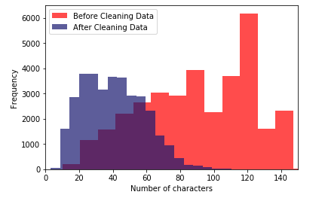
BEFORE AND AFTER CLEANING

Slide 7
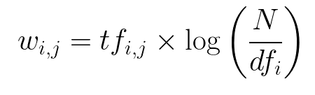
SUPERVISED LEARNING
Created Dictionary : Maps all words to its unique ID
This dictionary is used to create a bag-of-words corpus, which contains the word id and its frequency in each document
Document term matrix is created.
TF-IDF
Created TF-IDF model
TF-IDF score (w) for a word in a document in the corpus is

Slide 8
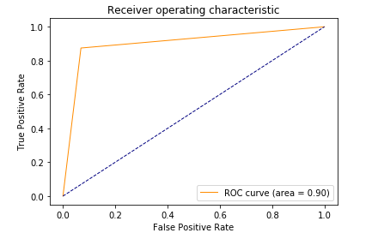
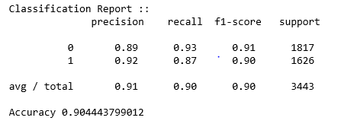
MACHINE LEARNING
Applied various machine learning algorithms and compared their results
Support Vector Machine
Linear SVM model is created using training data
Classification accuracy is 90%

Slide 9
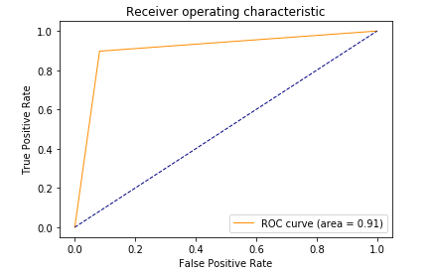
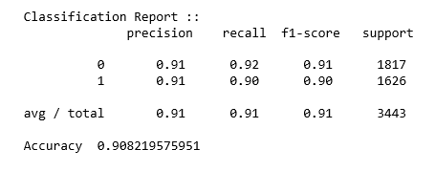
Random Forest
Random Forest classifier is created using training data
Classification accuracy is 90%

Slide 10
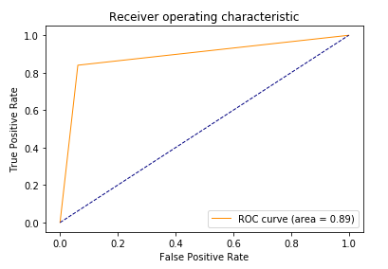
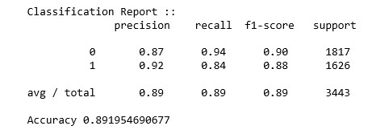
XGBoost
XGBoost classifier is created using training data
Classification accuracy is 89%

Slide 11
UNSUPERVISED LEARNING
Latent Dirichlet Allocation (LDA)
Latent Dirichlet allocation (LDA) is a topic model that generates topics based on word frequency from a set of documents.
LDA is particularly useful in finding reasonably accurate mixtures of topics within a given document set.
Measures to Evaluate Topic Modelling
Coherence
Perplexity

Slide 12
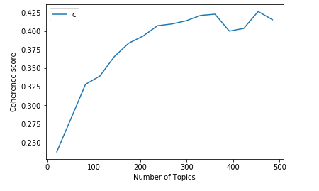
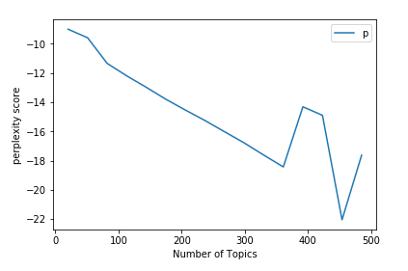
Coherence And Perplexity
Coherence
Coherence is defined as the average / median of the pairwise word-similarity scores of the words in the topic
Perplexity
Perplexity is a measurement of how well a probability distribution or probability model predicts a sample

Slide 13
LDA
Created LDA model with 250 topics.
Converted topics into feature vectors
Here we used minimum probability parameter to ensure that we’ll capture the instances including the probabilities where presence of tweet in some topics is nearly zero
Applied Machine learning models.

Slide 14
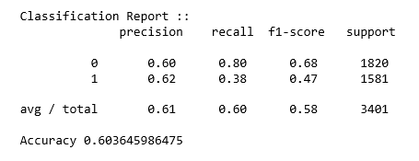
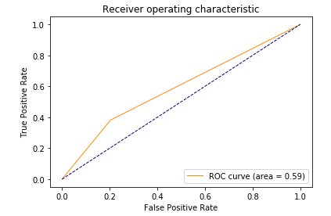
MACHINE LEARNING
Support Vector Machine
Classification accuracy is 60%

Slide 15
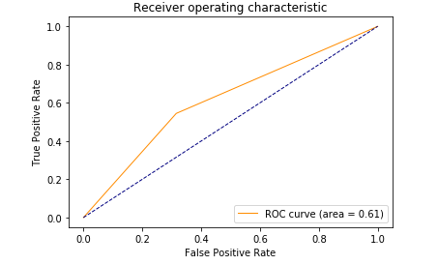
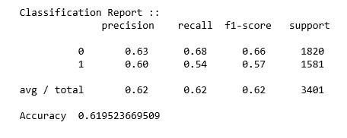
Random Forest
Random Forest classifier is created using training data
Classification accuracy is 61%

Slide 16
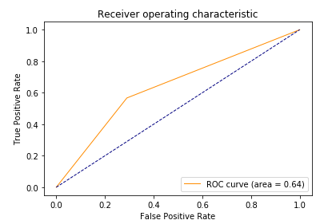
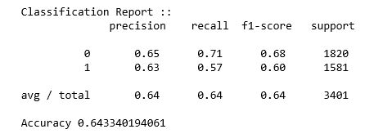
XGBoost
XGBoost classifier is created using training data
Classification accuracy is 64%

Slide 17
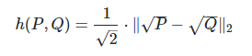
TOPIC SIMILARITY NETWORK
Graphs in which nodes represent latent topics in text collections and links represent similarity among topics.
Similarity between the topics is computed using the Hellinger distance
Hellinger Distance
Hellinger distance is a metric to measure the difference between two probability distributions.
Given two probability distribution P, Q Hellinger distance is given as

Slide 18
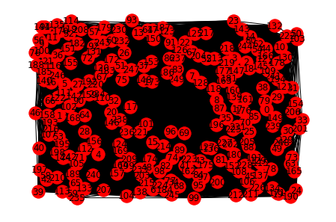
TOPIC SIMILARITY NETWORK
Nodes : Topic Numbers
Edges : Hellinger distance between topics (< 50 percentile value)

Slide 19
COMMUNITY DETECTION
Topics are clustered using community detection.
Good communities should have maximum intra-community edges and minimum inter-community edges.
Communities in the network are detected using Louvain community detection method.

Slide 20
LOUVAIN COMMUNITY DETECTION
Louvain Community detection
A heuristic method based on modularity optimization.
Finds partitions with high modularity.
Follows multilevel hierarchical scheme.

Slide 21
ALGORITHM
Different community is assigned to each node of the network.
Phase I
For each node we evaluate the gain of modularity by removing node from its community and by placing it in the community of its neighbor.
The node is then placed in the community for which this gain is maximum
Repeat until no further improvement
Phase 2
A new network is build, whose nodes are now the communities found during the first phase.
Repeat until no more changes

Slide 22
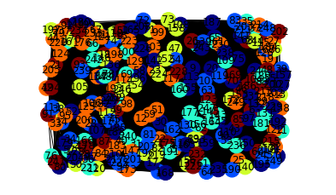
COMMUNITIES IN NETWORK
The Network of topics is grouped into 5 communities

Slide 23
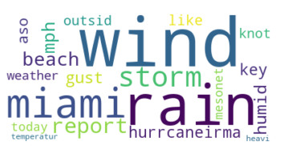

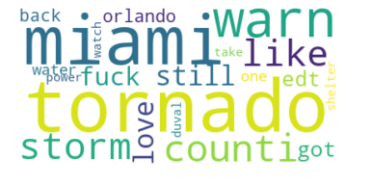
IRMA HURRICANE RELATED COMMUNITIES

Slide 24
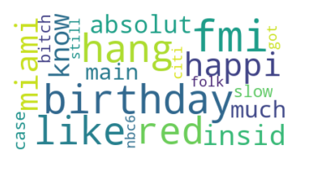
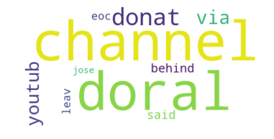
NON-HURRICANE RELATED COMMUNITIES

Slide 25
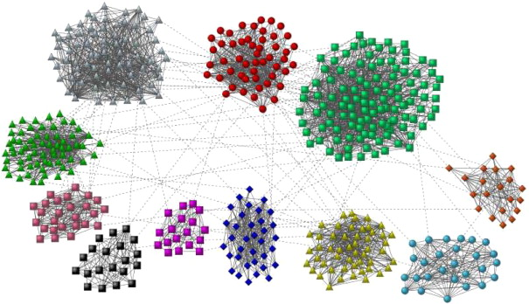

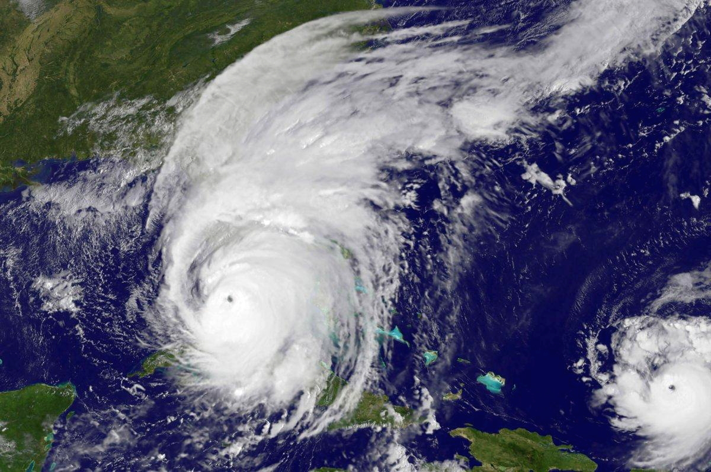
Balanced scorecard slide 8
CONCLUSION
Machine learning algorithms results in better performance given supervised learning model.
Louvain method can be used to detect communities in large network.
The Keywords with high probability within communities helps us to determine context of the community.
Twitter analysis during disasters and emergencies can be used by disaster responders for crisis response and management.

Slide 26

Balanced scorecard slide 10
https://github.com/mounakalidindi/Twitter-Hurricane-Analysis
THANK YOU

